Slide 1
Infosys SpringBoard Virtual Internship
ElectViz Election data Visualization for Media
Mentor Name:
Ms. Nithyasri S J
Intern Name:
Arya Mishra

Slide 2
Introduction
ElectViz is a data visualization project developed using Power BI that focuses on transforming large-scale election data into interactive and easy-to-understand dashboards. The project presents election insights in a structured and visually engaging manner, making complex datasets more accessible to users.
The key issue addressed by ElectViz is the difficulty in analyzing and interpreting raw election data due to the lack of an interactive analytical platform. By leveraging Power BI’s advanced visualization and filtering capabilities, the project allows users to explore data efficiently while maintaining accuracy and depth. This results in improved clarity, transparency, and reliable, data-driven election analysis.

Slide 3
Objectives
To examine election data across multiple years, states, and constituencies for comprehensive analysis.
To evaluate political party performance by analyzing vote share, seats won, and overall dominance.
To gain insights into voter participation levels, including turnout trends and gender representation.
To assess electoral competitiveness using factors such as victory margins and the strength of winning candidates.
To deliver key findings through interactive, intuitive, and visually engaging dashboards.

Slide 4
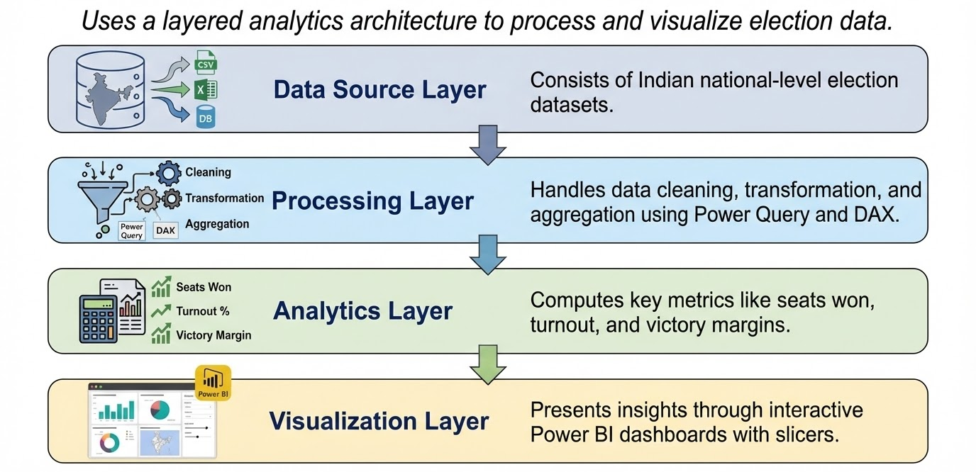
System Design

Slide 5
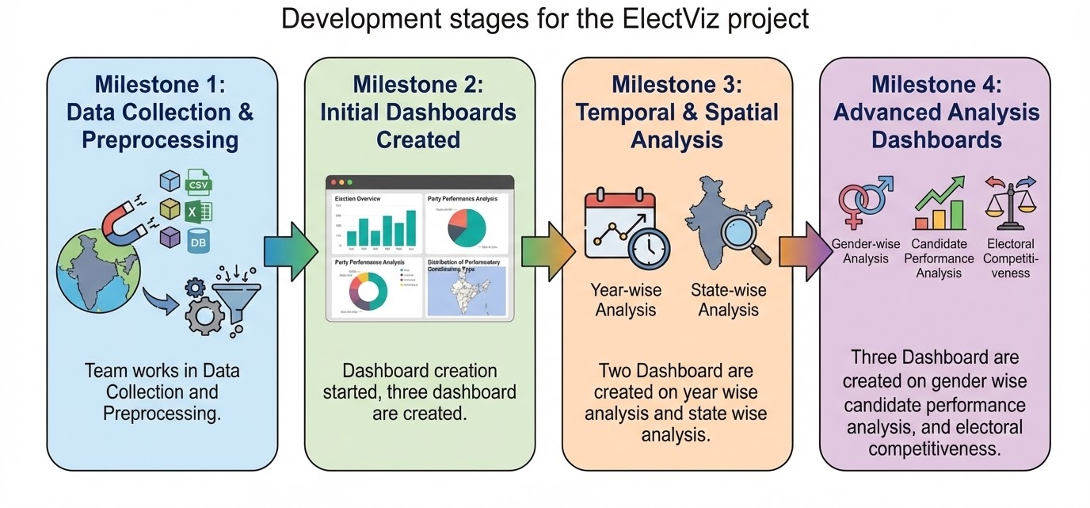
Workflow

Slide 6
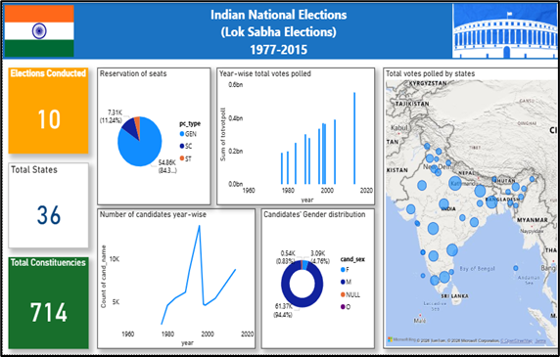
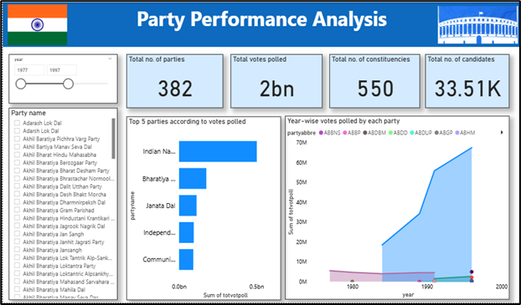
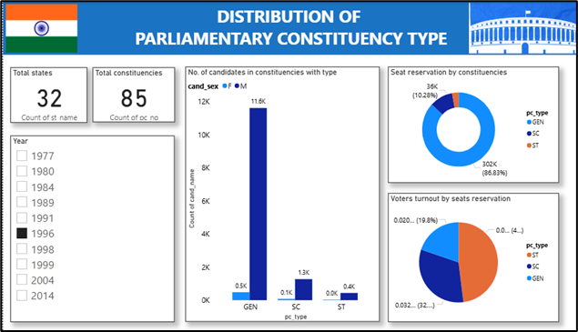
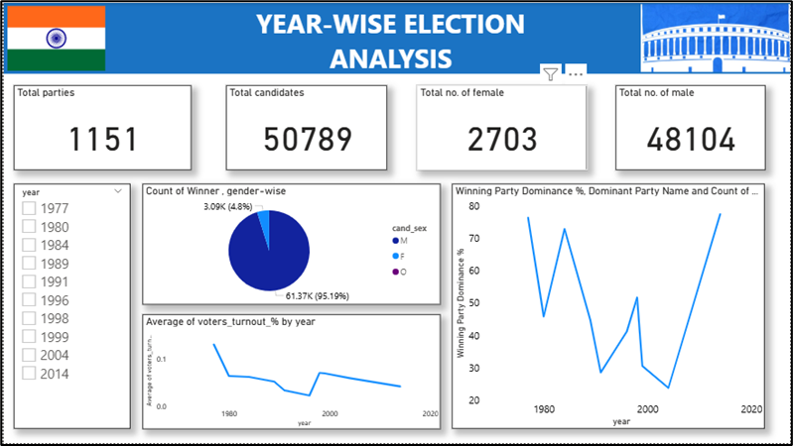
Dashboards

Slide 7
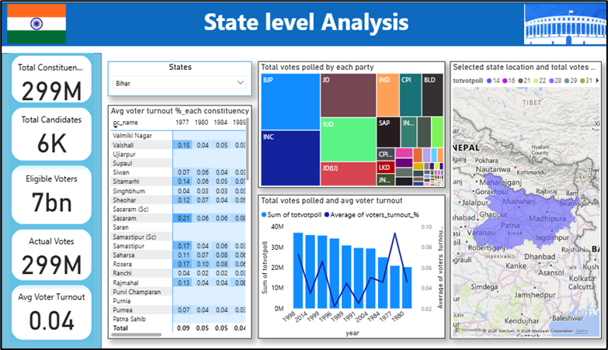
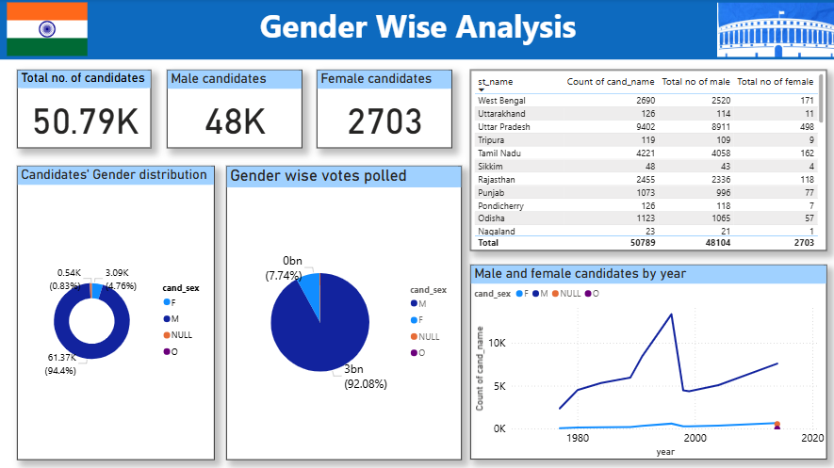
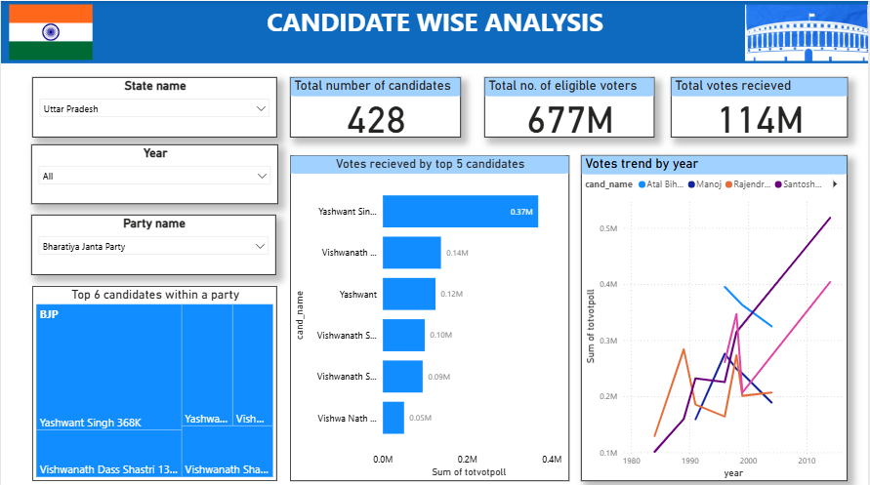
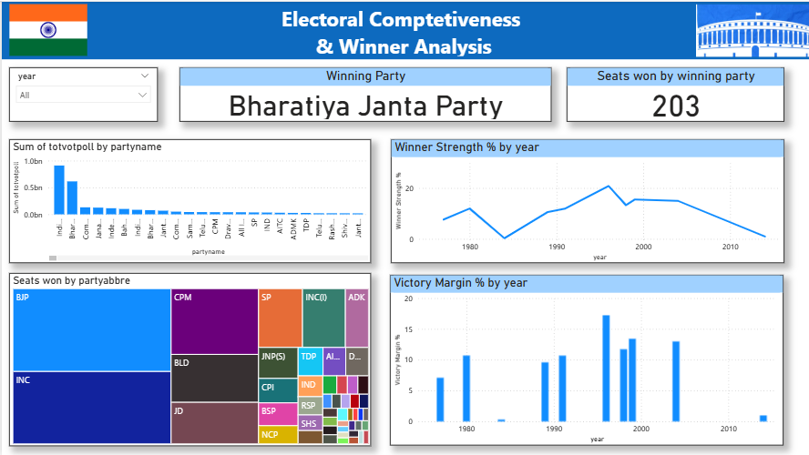
Dashboards

Slide 8
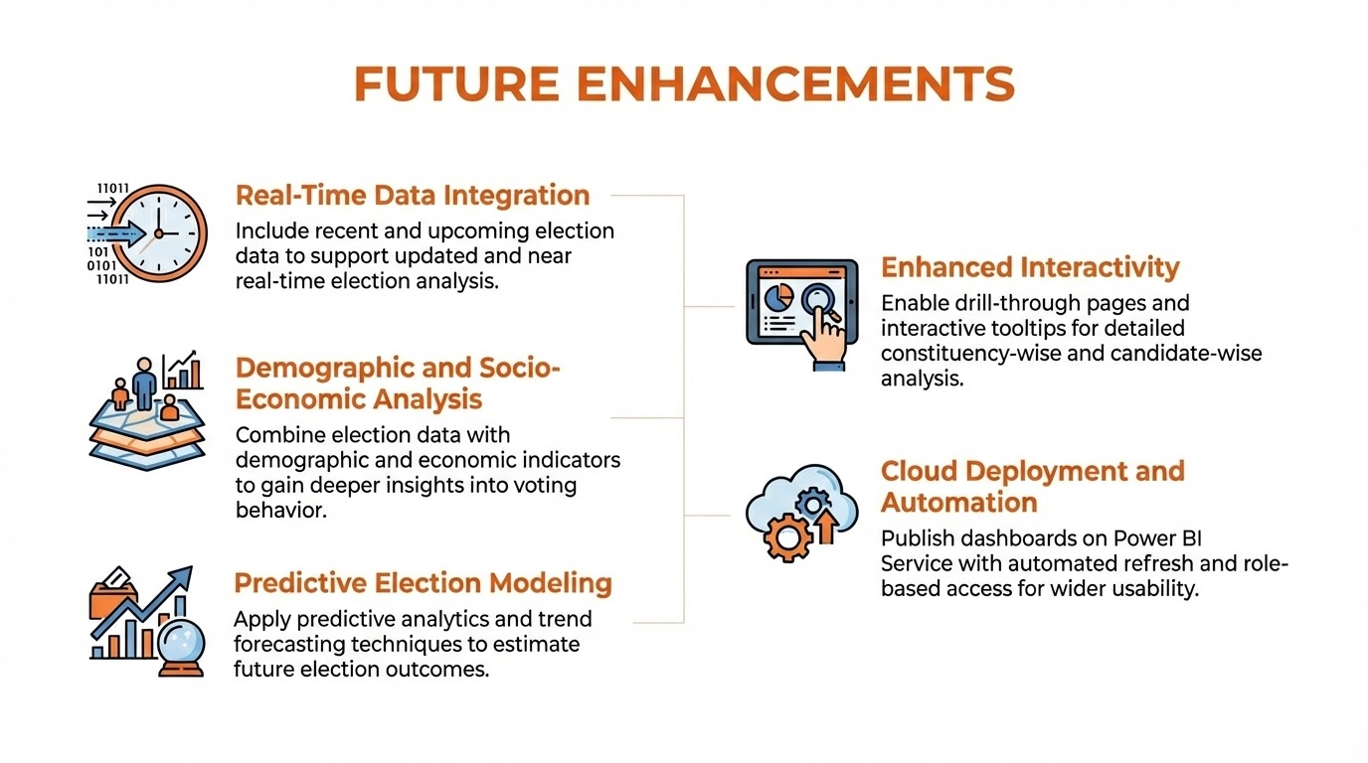

Slide 9
Conclusion
ElectViz effectively connects raw election data with meaningful public insights through a centralized and automated visualization system. The project converts complex electoral datasets into clear, interactive dashboards using features such as geographic maps and swing analysis visuals. This approach minimizes delays and reduces manual errors commonly found in traditional reporting methods. A well-structured data pipeline enables timely insights, helping analysts and media teams quickly identify trends like voter shifts and anti-incumbency patterns. Overall, ElectViz provides a scalable and efficient solution that strengthens transparency and delivers presentation-ready election insights for modern digital platforms.

Slide 10
Acknowledgement
We would like to express our heartfelt gratitude to :
Infosys Springboard Team - for organizing this valuable internship opportunity.
My Mentor - for her continuous support and feedback.
My Teammates - for collaboration, encouragement, and insights
This internship has been a significant step in our professional growth and technical journey and we are grateful to be a part of this great learning experience.
References
Election Dataset(Indian Election Dataset/ Kaggle source)
“Indian Election Dataset” by Nanadan Pandey https://www.kaggle.com/datasets/awadhi123/indian-election-dataset
Microsoft Power BI Documentation
Infosys Springboard Virtual Internship course materials

Slide 11
Thankyou!

